Slide 1
Exploratory Data Analysis and optimum feature selection using R
Yash Singhal

Slide 2
Exploratory Data Analysis
Exploratory Data Analysis refers to the critical process of performing initial investigations on data so as to discover patterns,to spot anomalies,to test hypothesis and to check assumptions with the help of summary statistics and graphical representations.
In other words , it's a process to get familiar with the data set and facilitate further working
Usually performed after the data Wrangling portion and also considered one of the key steps in predictive modelling if that’s your end goal. However Typical usage of this process is to find insights with the data you have
Encompasses both graphical and non graphical ways of looking at the data

Slide 3
Exploratory Data Analysis
Usually starts with the Question “What you really want to achieve ?”. One example could be while working on the Titanic Dataset asking Whether age was instrumental in deciding if one survives in Titanic.
Supposed to Be dirty, quick and not meant for reporting. It’s basically your process to better acquaint yourself with data
Considered an Art and have no right answer. Better you find relationships between the attributes and get comfortable with your dataset easier would be the analysis or your working towards your end process
Usual operations include looking at the relationship between single attributes and response variables, relationships between the multiple attributes etc

Slide 4
Common Types of Data
Categorical : Have no statistical significance and is merely a way to represent different items. Ex Different Hair Colors, Blood group of Person. Mean mode and other statistical measure does not make any strength
Ordinal: Similar to Categorical but with an implied Ordering. For example the grades obtained in the Scholar while indeed Categorical but have an ordering
Quantitative Attributes: Numerical Features on which statistical tools can be applied and make sense. They in effect represent True numbers
A better Analogy would Be - A difference of 12 which is categorically encoded through 1 to 12 does not necessarily mean the same difference of 12 in quantitative attributes

Slide 5
Common forms of EDA
Univariate Analysis: This involves looking at the features or attributes one at a time to gain better understanding of your Data set. Typical usage include looking at the descriptive measures like spread, central tendency to gain better understanding which attributes might be instrumental in answering your end goal. After this process you will have a set of important attributes for further analysis
Multivariate Analysis: This involves taking the above set of attributes and doing analysis taking two or more at a time (Usually Two). This step usually involves identifying relationship for instance between the pair of feature, or most commonly identifying relationship between a attribute and a response variable
Always Perform univariate data analysis before multivariate.

Slide 6
Looking at the Data
There are two ways of looking at the data in EDA
Non- Graphical : Provides the concrete statistical summary of your attributes. Generally not that much useful as Humans are not often great at interpreting these number particularly in large datasets. Nevertheless they might be useful in proving whether your gut feeling is misplaced
Graphical : Diagrammatic Summarization of your attributes. Combined with the well drawn plots , it provides a wealth of information. It is also possible through plot to interpret data easily in 3 dimension like for instance analysis of two quantitative and one response variable which is not that much feasible in Non graphical

Slide 7
Summarization
Univariate Non graphical EDA
Univariate graphical EDA
Multivariate Non graphical EDA
Multivariate graphical EDA

Slide 8
Notebook

Slide 9
Univariate Non graphical EDA
Categorical - Simple Tabulation of freq for each frequency
Quantitative or Ordinal- Sample Statistics
Central Tendency- A point Estimate for the data
Mean -> Ideal for Symmetric Distribution
Median -> Robust and Ideal for Non symmetric Distribution. Hence widely used
Mode -> Rarely Used and only used to check whether data is uni or multi modal
Spread- Calculate Dispersion or how far away from the mean
Variance - Sum of square deviation. Far away point are weighted Heavier
Standard Deviation - Square root of Variance
IQR(Interquartile Range)- Robust : Difference between 3rd and 1st quartile

Slide 10
Univariate Graphical EDA
Categorical- Bar Plot
Quantitative or Ordinal -
Histogram
Bars run vertically with the count axis and bin width depicting range
Bin Width is an iterative approach and may need some adjustment to determine modality and skewness. Generally used to about 30
Histogram are one of the best way to quickly learn a lot about data, including central tendency spread modality and outlier
Box Plots
Perfect for visualizing skewness, central tendency as well as providing information regarding where most of data lies and Outliers

Slide 11
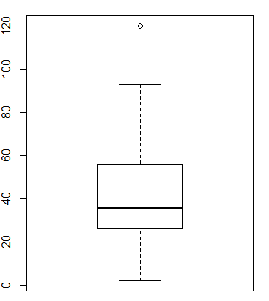
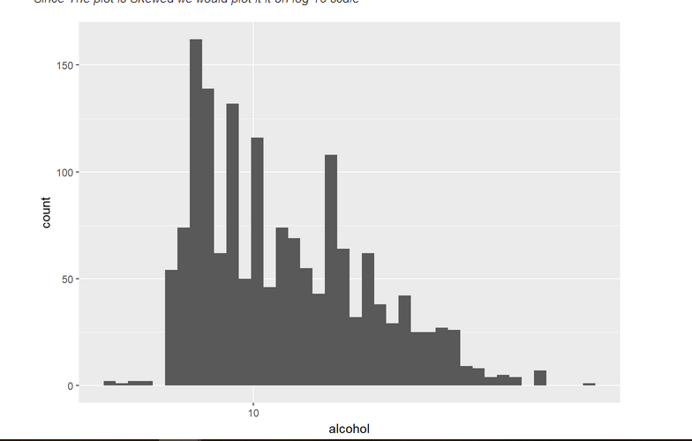
Boxplot
Histogram

Slide 12
Multivariate Non Graphical EDA
Categorical & Categorical
Cross Tabulation- A matrix form to input data
Categorical and Quantitative
Perform Groupby operations on each categories and perform statistical summary within each group
 | Female | Male
Yes | 25 | 12
No | 34 | 76

Slide 13
Multivariate Non Graphical EDA
Quantitative and Quantitative
Covariance
Measures of how much two attribute co-vary , how much we expect one variable to change when other changes
Positive Covariance suggest that one is above the mean , other would be above the mean as well and vice versa
Difficult to Interpret as the values are unbound
Correlation
Most Widely used
Conceptually same as covariance but within the range -1 to 1
0 indicates independence

Slide 14
Multivariate Graphical EDA
One Categorical and One quantitative
Side by Side Boxplot
Extensively used and gives out a breadth of information
Can be used as a tool to compare very easily. Infact the best way
One Quantitative and One Quantitative
Scatterplot
Traditional method to compare two numerical attributes
Non Complex Visualization which helps us to explore how change in one var changes other
Two Quantitative Attributes with one or more Categorical
Scatterplot
Categorical column can be encoded in the form of shapes and sizes to decode extra information

Slide 15
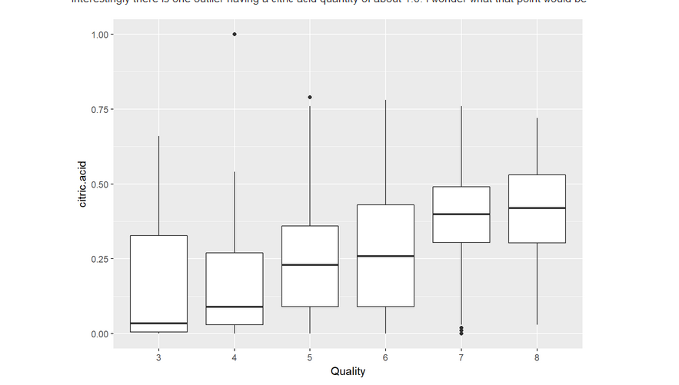
Side by Side Boxplot

Slide 16
A quick note regarding Outlier
Boxplot have a well defined definition of outlier ie: Observation which are 1.5 times the IQR at both sides are considered outlier
In practice there is no well defined definition of outlier in statistics .
Outlier should be analyzed properly and questions should be asked where that observation might have come as that outlier might have some significance regarding the question asking
Example : Healthcare spending per person in the US. The top 1% of people who use healthcare in the US account for over 20% of the total money spent on healthcare. These people are outliers. However, they provide us with a tremendous amount of information about the nature of ill health and how we might better address it.

Slide 17
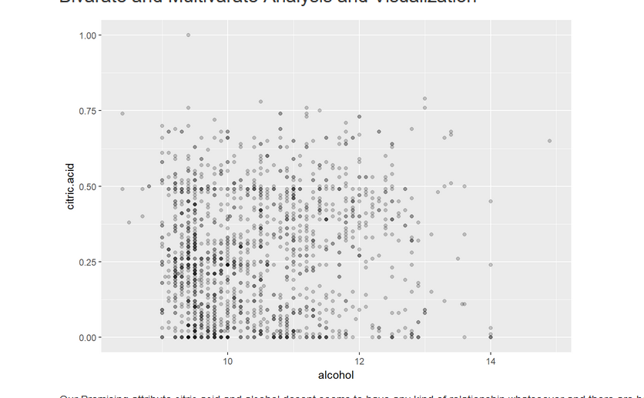
Scatter Plot

Slide 18
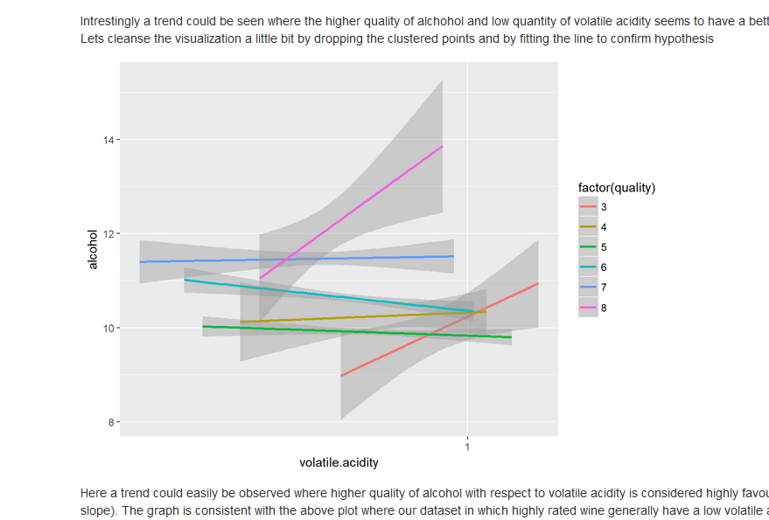
Scatter plot with More than 2 dimensions

Slide 19
Importance of EDA in feature Selection
Check the distribution and spread of the individual attributes for predictive modelling. A attribute which have a larger spread might give poor performance and need some form of data transformation to avoid dominance by that attribute
Response Variable in which no of observations of one Category is much greater than the other might lead to the class Imbalance and thus need some undersampling or oversampling
Ordinal Variable and Categorical Variables should be handled with care. One hot encoding for pure categorical variable
Relationship between the two quantitative attributes might be important.While we do want to keep the features where attribute is correlated with response variable . We might want to keep out the attributes which are highly correlated with another attribute to avoid Redundancy and possible performance loss (ie Regression)

Slide 20
Questions
Contact me at
yashgyy@gmail.com
linkedin.com/yashsinghaldev
Follow on twitter @yashgyy

